Slide 1

Presentation
on
A Vision for Better Health: HealthCare’s 6-in-1 Medical Project for Disease Detection by Using Machine Learning and Deep Learning
Bachelor Of Engineering
in
Computer Science and Engineering(Data Science)
BY
1.P.SWAMY (20K91A6730) 4.J.SWATHI (20K91A6714)
2.B.LIKITH (20K91A6705) 5. K.DAVID (20K91A6719)
3.G.MANVITHA (20K91A6707)
Under the esteemed guidance of
MRS.YASMEEN SHABNUM (Assist. Prof.)
TKR COLLEGE OF ENGINEERING & TECHNOLOGY(AUTONOMOUS)
Meerpet, near LB Nagar, Hyderabad, Telangana, India 2022-2023

Slide 2
Agenda:
Introduction
Abstract
Literature Review
Problem Statement
Existing System
Proposal System
Architecture
Screen shots
Conclusion

Slide 3
Introduction:
In today’s world the most common issue faced by people is health related diseases. One out of ten is suffering with some or the other diseases. some may be not critical but few may lead to deaths.
There are many disease detection systems but we came across and idea of detecting six diseases on a single interface with high accuracy and less response time.
It provides test from home facility at reasonable prices.
After detecting the disease we may further recommend medications and precautions to be taken.

Slide 4
Abstract:
In recent times it is difficult for all of us and every second person around is suffering from one or the other disease, that’s why we are making a try to bring everything under one platform.
The main advantage of this project is that we can get the test results quickly at our home with a just few steps.
Here we consider various factors like X-rays ,MRI scans and obtained sample results and detect the diseases basing on them.
That’s why we came with an idea of creating an online platform where we can bring together all of these disease detections under one roof. It contains both simple and advanced type of detections and uses almost every aspect of ML and DL.
KEYWORDS: Disease Detection, Simplified health care, Advanced detections, Integrated solutions.

Slide 5
6 Disease Detections:
Covid-19 detection
Brain Tumour detection
Breast Cancer detection
Alzheimer detection
Diabetes detection
Heart disease detection

Slide 6
Existing systems:
Existing systems are spread across different platforms, each focusing on specific diseases.
These systems exhibit lower accuracy due to reliance on outdated technologies.
Only limited disease coverage, results from separate platforms for different diseases.
Outdated algorithms in these systems contribute to compromised performance.
The user interface of these systems is complex and user-unfriendly.
Existing systems may have less response time.

Slide 7
Limitations Of Existing systems :
Less Accuracy
More Response Time
More Expensive
Non User- Friendly

Slide 8
Recursion Enhanced Random Forest With an Improved Linear Model (RERF-ILM) for Heart Disease Detection on the Internet of Medical Things Platform
Literature Review:
Property | Details
Title | Recursion Enhanced Random Forest With an Improved Linear Model (RERF-ILM) for Heart Disease Detection on the Internet of Medical Things Platform
Authors | Chunyan Guo, Jiabing Zhang, Yang Liu, Yaying Xie, Zhiqiang Han, Jianshe Yu
Affiliations | 1. Anesthesiology Department, The Affiliated Hospital of Inner Mongolia Medical University, Hohhot 010050, China
Limitations | The paper proposes the RFRF-ILM model for heart disease detection using machine learning techniques. It aims to identify key features for predicting cardiovascular diseases and analyzes factors contributing to them. The model achieves 96.6% accuracy, 96.8% stability ratio, and 96.7% F-measure ratio. Heart disease detection, Linear model, Random forest, Machine learning, Diagnosis

Slide 9
Brain Tumor Detection Based on Multimodal Information Fusion and Convolutional Neural Network:
Property | Details
Title | Brain Tumor Detection Based on Multimodal Information Fusion and Convolutional Neural Network
Authors | Ming Li, Lishan Kuang, Shuhua Xu, and Zhanguo Sha
Affiliations | 1. Department of Nuclear Medicine, Rizhao People’s Hospital, Rizhao 276826, China
 | 2. Department of Radiology, Rizhao People’s Hospital, Rizhao 276826, China
Published in | IEEE Access, 2019
Limitations | This paper presents a brain tumor detection method called Multi-CNNs, which combines multimodal information fusion and convolutional neural networks (CNNs). It extends 2D-CNNs to multimodal 3D-CNNs to capture brain lesions under different modal characteristics in three-dimensional space. Real normalization layers are added between convolution layers and pooling layers to improve network convergence speed and mitigate overfitting. The loss function is enhanced, and a weighted loss function is used to improve feature learning in the lesion area. Experimental results demonstrate effective tumor lesion localization,
Index Terms | Multimodal, fusion, convolutional neural network, brain tumour

Slide 10
CXR-Net: Deep Learning for COVID-19 from Chest X-Ray Images
Property | Details
Title | CXR-Net: Deep Learning for COVID-19 from Chest X-Ray Images
Authors | Xin Zhang, Liangxiu Han, Tam Sobeih, Lianghao Han, Nina Dempsey, Symeon Lechareas, Ascanio Tridente, Haoming Chen, Stephen White, Daoqiang Zhang
Affiliations | 1. Manchester Metropolitan University, U.K.
 | 2. Brunel University, U.K.
Limitations | CXR-Net is a deep learning model designed for COVID-19 pneumonia diagnosis using chest X-ray (CXR) images. It introduces an Encoder-Decoder-Encoder architecture, improving transparency and accuracy in diagnosis. Tested on real-world datasets, it achieves high accuracy in detecting COVID-19 pneumonia. CXR-Net provides detailed visual explanations and can be deployed in various computing environments, promising clinical utility.
Index Terms | CXR imaging, COVID-19, Deep learning, Model explanation/explainable AI

Slide 11
A Novel Hybrid K-Means and GMM Machine Learning Model for Breast Cancer Detection
Title | A Novel Hybrid K-Means and GMM Machine Learning Model for Breast Cancer Detection
Authors | P. Esther Jebarani, N. Umadevi, Hien Dang (Member, IEEE), Marc Pomplun
Affiliations | 1. Department of Computer Science, Sri Jayendra Saraswathy Maha Vidyalaya College of Arts and Science, Coimbatore, India 2. Faculty of Computer Science and Engineering, Thuyloi University, Hanoi, Vietnam 3. Department of Computer Science, University of Massachusetts Boston, Boston, MA, USA
overview | Breast cancer is a major health issue, and early detection is crucial. This paper presents a hybrid approach that combines segmentation techniques with machine learning to classify benign and malignant tumors, enabling faster and more accurate breast cancer diagnosis.
Index Terms | - Breast cancer - Pre-processing - Adaptive median filtering - K-means - EM algorithm - Gaussian mixture model - ANOVA
Limitations | The paper emphasizes the importance of early breast cancer detection and discusses genetic and environmental factors contributing to breast cancer. The main contribution is the segmentation of cancerous cells using a hybrid technique for detection.
 | The paper describes the methodology used for breast cancer detection, including the application of adaptive median filtering for noise removal and image enhancement, as well as the integration of K-means and Gaussian mixture model (GMM) for classification. The methodology is discussed in detail.

Slide 12
Literature Review CONCLUSION:
The system's limitations include reduced accuracy, longer response times, increased expenses, and a lack of user-friendliness. These factors can diminish reliability, efficiency, affordability, and ease of use, respectively, impacting the overall effectiveness and user experience. Addressing these limitations is crucial to enhance the system's performance and usability.

Slide 13
Problem Statement:
A Vision for Better Health
HealthCare’s 6-in-1 Medical Project for Disease Detection to develop AI-powered Online Medical Diagnostics Platform which revolutionize medical science with an integrated platform using AI and ML for rapid disease detection with high accuracy only on a single application rather than the existing systems that uses different applications for different disease detections.

Slide 14
Proposed system:
To develop a unified platform for detecting all six diseases.
Achieve high accuracy levels within a short processing time.
Enable disease detection from home, promoting early identification.
Offer disease detection at reasonable and accessible pricing.
Design a user-friendly system for efficient and intuitive usage.
Usage of advanced applications results desired performance.
. Considering various factors like X-Ray, MRI scans and obtained sample results and detecting the diseases basing on them.

Slide 15
Objectives:
Comprehensive Disease Detection Platform
Convenient Home Test Results
AI and ML Integration for Accuracy
Simplified Healthcare Solutions
Revolutionizing Medical Science
Single Application for Multiple Disease Detection

Slide 16
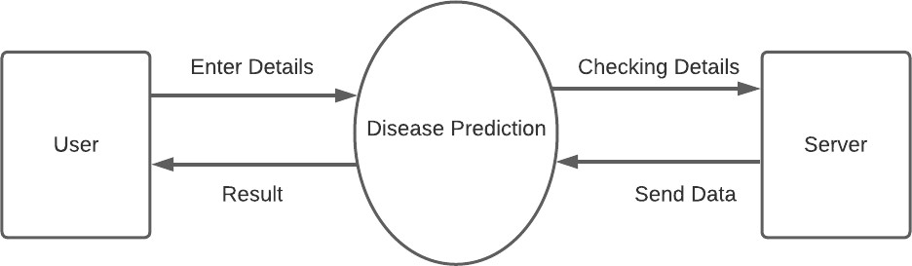
DATA FLOW DIAGRAM
ZERO LEVEL DFD

Slide 17
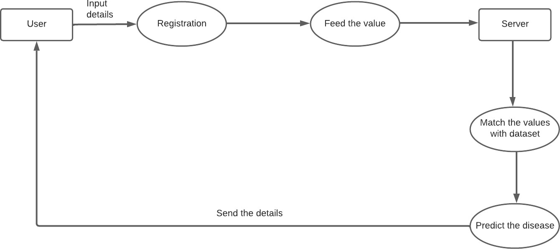
FIRST LEVEL DFD

Slide 18
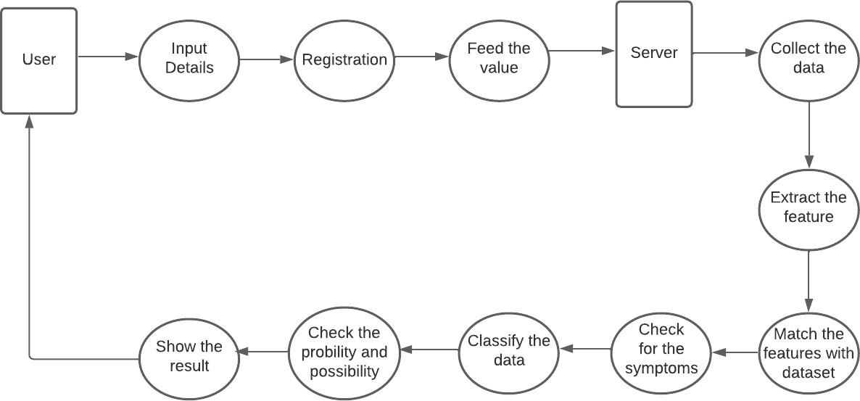
SECOND LEVEL DFD

Slide 19
Symptoms
BP, Type chest pain, age ,no. major vessels
Heart
Architecture Diagram:
Brain tumor
Brain MRI
Image
Name
age
About us
Covid 19
Chest X-RAY
Image
User
Home
Diseases
Diabetes
Symptoms
Bp ,glucose ,Insulin,Bmi etc..
Contact
Contact us
Gender
Alzheimer
Brain MRI
Image
Symptoms
Gender,concave point,permeter mean
Breast

Slide 20
Technologies used:
Software:
Python: Core
Anaconda: Environment
TensorFlow: Accelerated
Flask: Web
OpenCV: Images
Hardware:
laptop

Slide 21
Methodology:
Problem Definition: Identification
Data Collection: Gathering
Data Preprocessing: Cleaning
Feature Engineering: Extraction
Data Splitting: Segmentation
Model Selection: Choosing
Model Building: Training
Model Evaluation: Assessment
Model Optimization: Refinement
Final Model Selection: Selection
Testing and Deployment: Deployment
Monitoring and Maintenance: Maintenance
Documentation and Reporting: Reporting

Slide 22
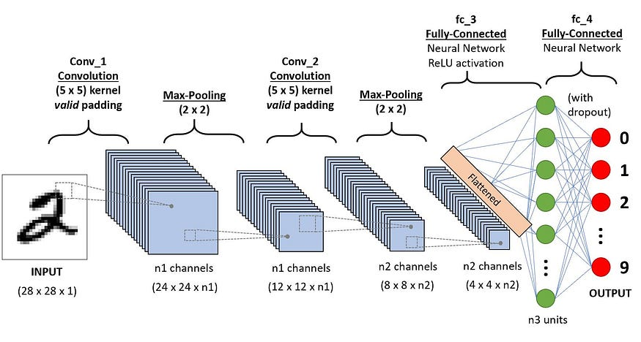
CNN:

Slide 23
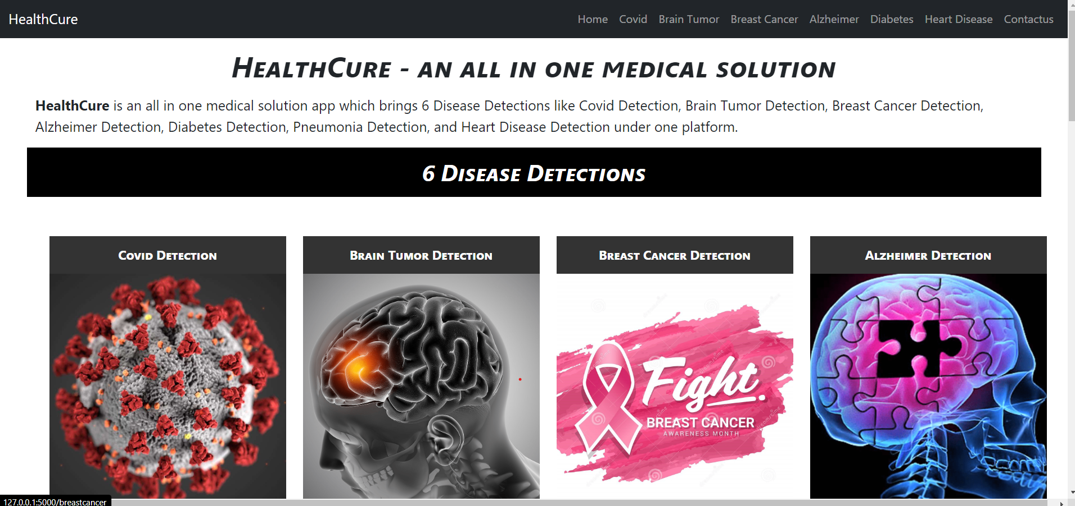
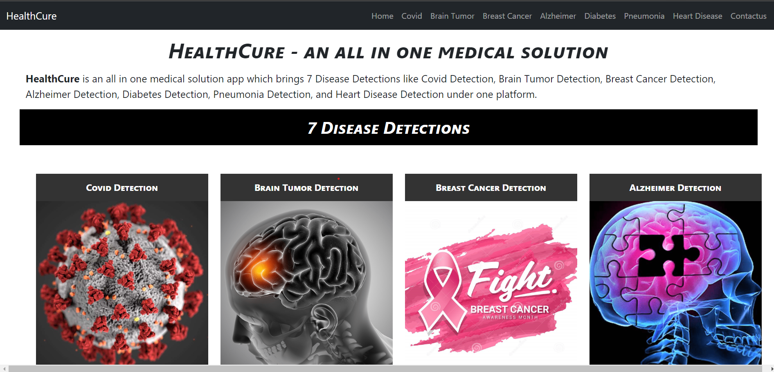
SCREEN SHOTS:
Home Page:

Slide 24
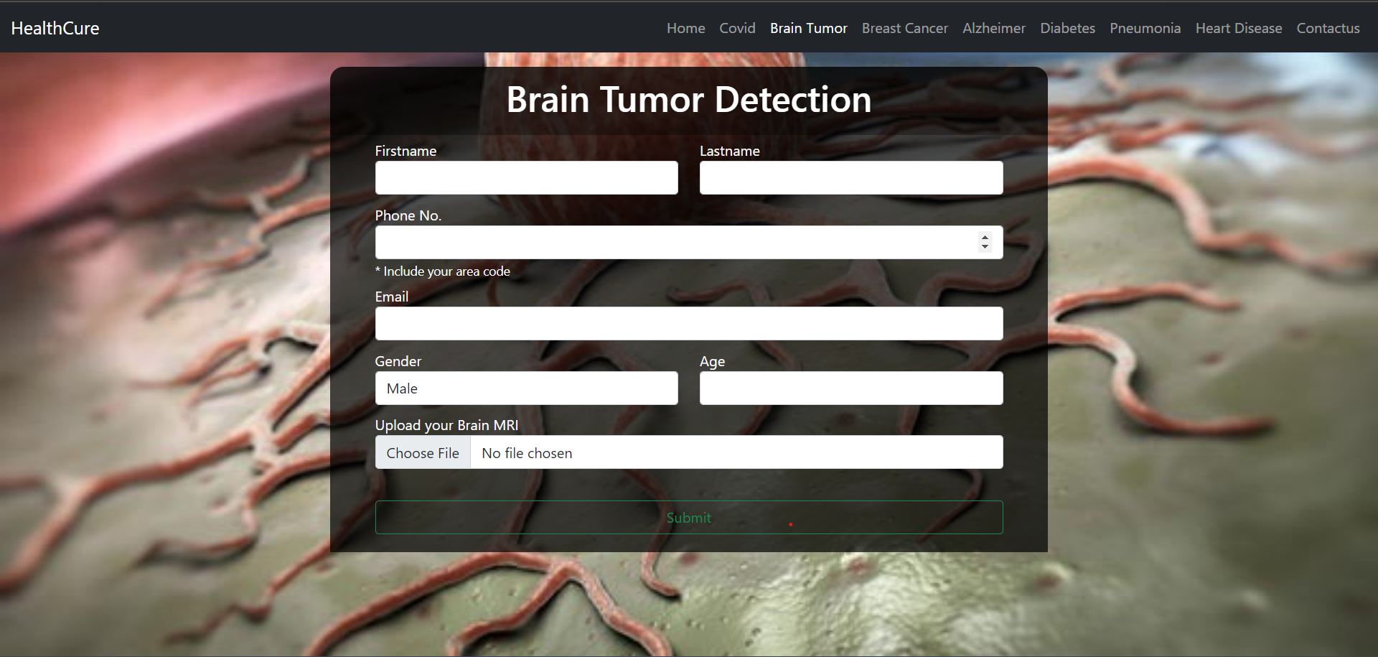
Diseases page:

Slide 25
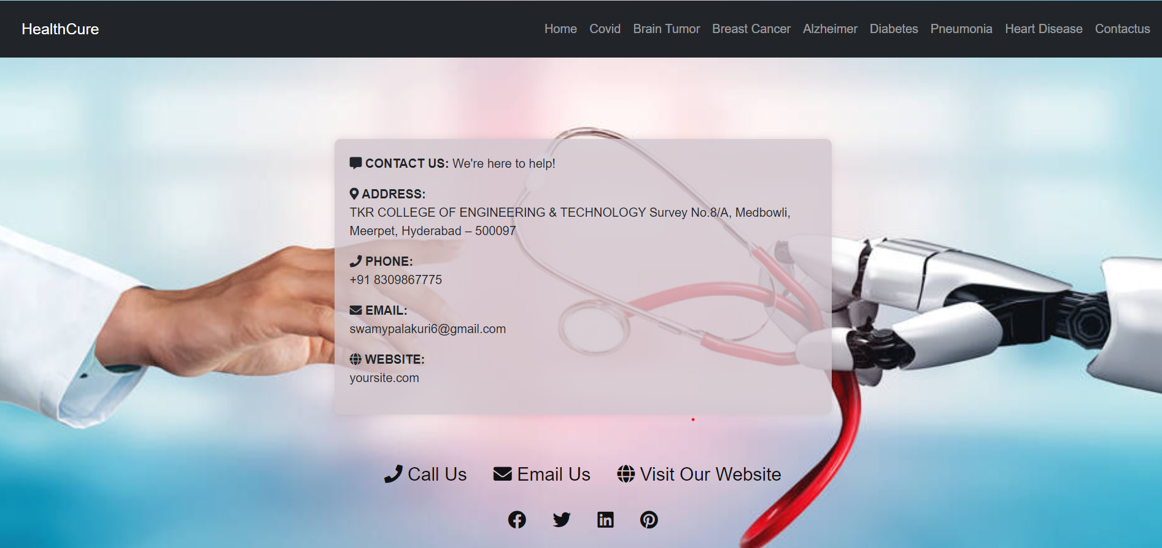
Contact Us Page:

Slide 26
CONCLUSION:
There are many existing systems for our project but ours make a difference in detecting all the six diseases on a single platform.
Our project will provide medical care at reasonable prices and can also be easily accessed from home which can give accurate results in shorter period of time.
This can be mainly useful in multi speciality hospitals and smart diagnostic centres.

Slide 27
Future Scope:
With increasing time , large amount of data is available and by training the data ,accurate and precise results can be obtained.
Addition of other more disease detections that can be detected using X-ray scans or just by inputting simple numerical.
We also had an extended plan of adding various features. For example,if a person is found positive then our app advises the precautions to be taken and make him aware of self curing.
Track of detection records can be maintained.
So the above are the few improvements/modifications which can be done in the future .

Slide 28
Thank You !!!
ANY QUERIES …?

